Slide 1
Web Application:
Client-Server Architecture
Sources:
www.csee.umbc.edu/~dondim1/104
www.csc.villanova.edu/~map/1020/javascript.ppt
cwo.ucsd.edu/_files/HTML5CSS3-ilin-final.ppt‎‎
csuf.kenytt.net/2012/spring

Slide 2
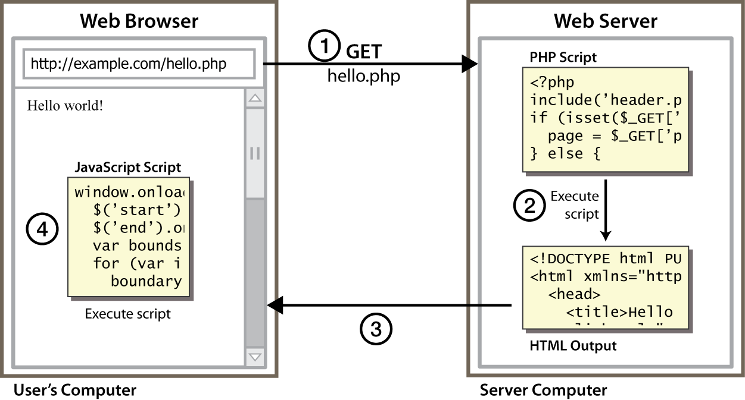
Client and Server Architecture using JavaScript (an Example)
Reference: http://stackoverflow.com/questions/25405966/difference-between-client-api-and-server-api

Slide 3
What is AJAX?
Asynchronous JavaScript and XML
Web development techniques used on the client-side to create asynchronous Web applications.
  Web applications can send data to/retrieve from a server asynchronously (in the background) without interfering with the display and behavior of the existing page.
  Data can be retrieved using the XMLHttpRequest object.
  HTML and CSS can be used in combination to mark up and style information.
  The DOM is accessed with JavaScript to dynamically display – and allow the user to interact with – the information presented.
  JavaScript and the XMLHttpRequest object provide a method for exchanging data asynchronously between browser and server to avoid full page reloads.
http://en.wikipedia.org/wiki/Ajax_%28programming%29

Slide 4
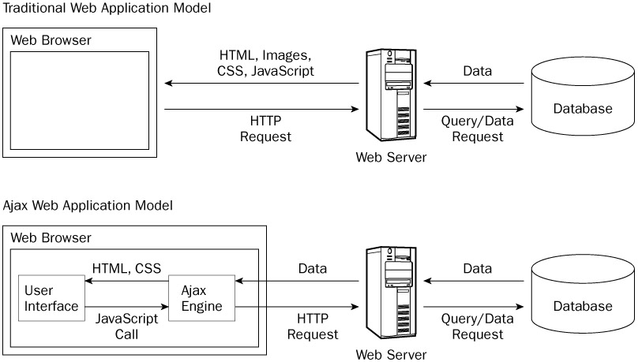
How Ajax Works
http://www.yaldex.com/ajax-tutorial-4/BBL0013.html

Slide 5
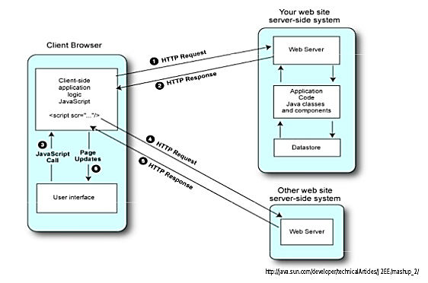
Client-Side Mashup
A client-side mashup: web pages running on the browser will directly access another site to mashup with.

Slide 6
Client-Side Mashup: Limitations
Too much application logic on the client side.
Some data can be shared by more than one client.
Slow in responding
Limit access to some services (e.g., bandwidth).
Security risks would be hard to mitigate on the client.
Customization may not be provided by the mashup website.
Using Ajax (XMLHttpRequest) on the client to make requests is constrained by the browser Javascript security model (restricts access to the server of origin of the web page).
Server side mashup with protocols (SOAP) will be easier.
When multiple Ajax requests were on the client, but the maximum allowed concurrent Ajax requests are limited (only 2 or 3).

Slide 7
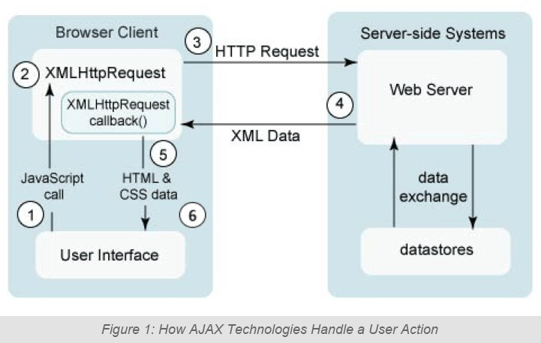
AJAX & Server-Side Java Technologies
handle a user action that triggers an AJAX response
https://sureshjain.wordpress.com/category/ajax/

Slide 8
AJAX and Server-Side Java Technologies
A user generates an event on the client. This results in a JavaScript technology call.
A JavaScript technology function creates and configures an XMLHttpRequest object on the client, and specifies a JavaScript technology callback function.
The XMLHttpRequest object makes a call — an asynchronous HTTP request — to the web server.
The web server processes the request and returns an XML document that contains the result.
The XMLHttpRequest object calls the callback function and exposes the response from the web server so that the request can be processed.
The client updates the HTML DOM representing the page with the new data. You can incorporate these technologies into a web application in a variety of ways.

Slide 9
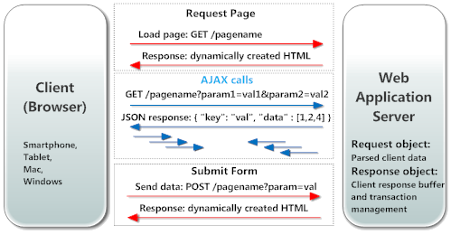
AJAX/JSON
AJAX and JSON are used by JavaScript code in modern web based user interfaces when querying the server in real time. JavaScript code may send URL-encoded data to the server, and the server may respond by sending back a JSON object.
https://realtimelogic.com/products/ajax/

Slide 10
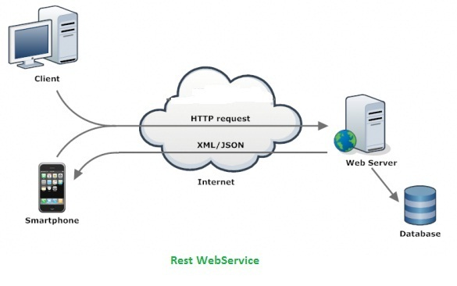
REST (Representational State Transfer)
Defined in 2000 by Roy Fielding as part of his thesis, “Architectural Styles and the Design of Network-based Software Architectures”, formalized as HTTP/1.1 (RFC2616)
An architectural style: client-server, stateless, cacheable, uniform representation, layered
Client transfers state with Web resource representation (URL)

Slide 11
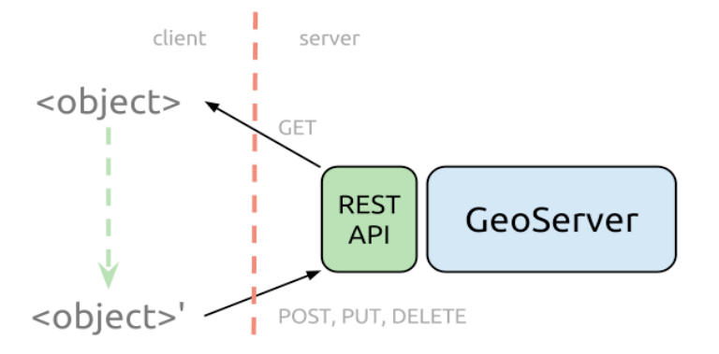
REST Operations, via the HTTP API
Web exchanges are done using this simple HTTP API:
  GET = "give me some info" (Retrieve)
  POST = "here's some update info" (Update)
  PUT = "here's some new info" (Create)
  DELETE = "delete some info" (Delete)
Messages are self-descriptive and stateless
  identify resources by uniform resource identifiers (URIs)
  manipulate resources through their representations
Source: http://blog.opengeo.org/2012/10/25/adding-layers-to-geoserver-using-the-rest-api/

Slide 12
Advantages
Better interactivity
AJAX allows easier and quicker interaction between user and website as pages are not reloaded for content to be displayed.
Easier navigation
allow easier navigation to users in comparison to using the traditional back and forward button on a browser.
Compact
several multi purpose applications and features can be handled using a single web page
Backed by reputed brands
several complex web applications are handled using AJAX (e.g., Google Maps, Google Mail)

Slide 13
Disadvantages
The back and refresh button are rendered useless
As all functions are loaded on a dynamic page without the page being reloaded or a URL being changed, clicking the back or refresh button would take you to an entirely different web page or to the beginning of what your dynamic web page was processing.
It is built on JavaScript A percentage of website surfers prefer to turn JavaScript functionality off on their browser rendering the AJAX application useless.
Development Time It usually requires more development time to build an application using AJAX than using other approaches.
Server Load Server load and bandwidth can be an issue when delivering AJAX-based solutions. The user may see fewer page reloads, but the server calls are still there.
Security data is sent as clear text. For this reason, no sensitive data should take a ride via HTTP using AJAX or any other technology.

Slide 14
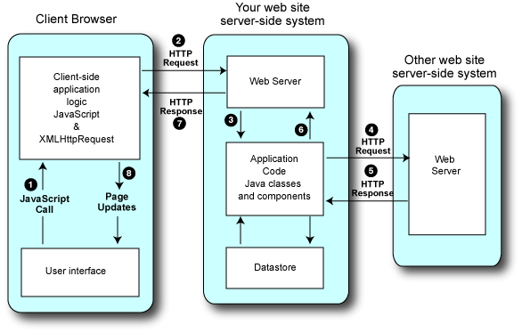
Server-Side Proxy Style Mashups
8. A callback function exposed in the XmlHttpRequest updates the client view of the page by manipulating the DOM that represents the page.
7. The servlet returns the response to the client.
6. The proxy class receives the response and optionally transforms it to an appropriate data format for the client. It can also cache the response for future request processing.
3. A web component such as a servlet receives the request and calls a method on a Java class (or on multiple Java classes). The class(es) (called proxy) encapsulates the code to connect and interact with the other web site in the mashup.
4. The proxy class processes the request, augments it as needed, and opens a connection to the mashup site, that is, the web site that provides the needed service.
5. The mashup site receives the request, usually in the form of an HTTP GET or HTTP POST, processes the request, and returns data to the proxy class.
A user generates an event in the client, typically a web page in a browser. The event triggers a JavaScript function in the client.
2. The client makes a request to the server in your web site. The request is typically an Ajax request in the form of an XmlHttpRequest object.

